Slide 1

Volume and Capacity EQ: What is the relationship between volume and capacity?

Slide 2
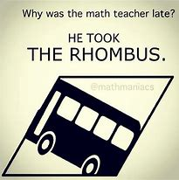
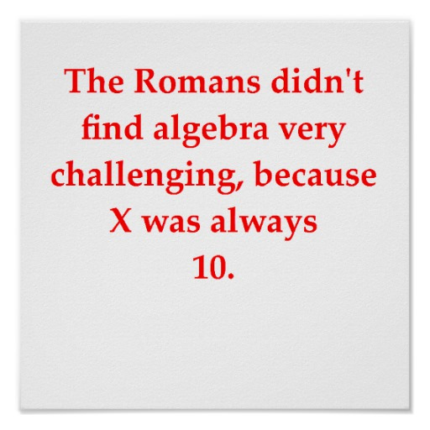
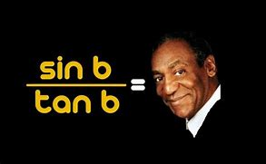
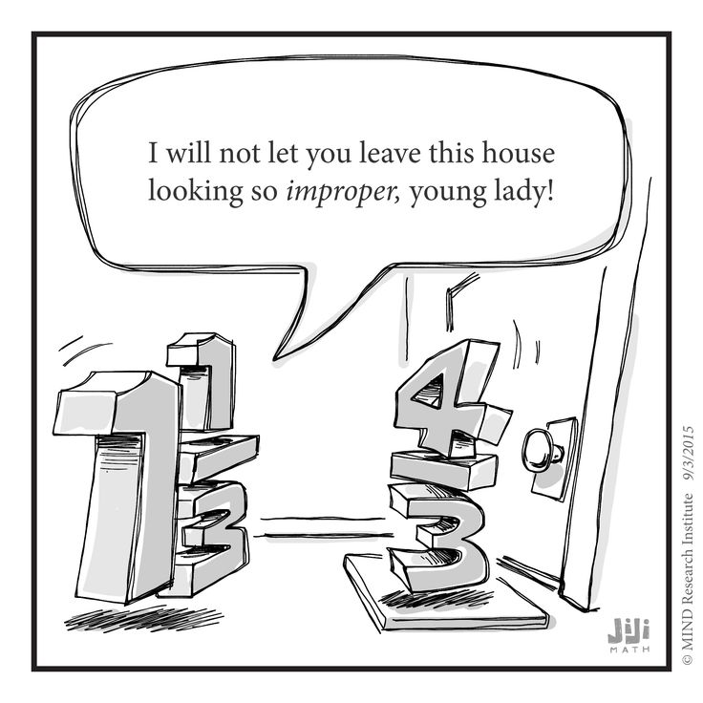
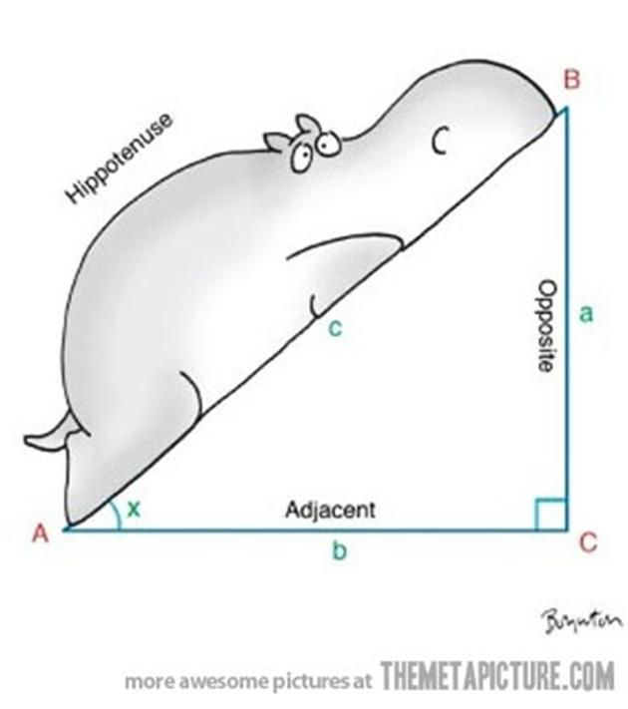
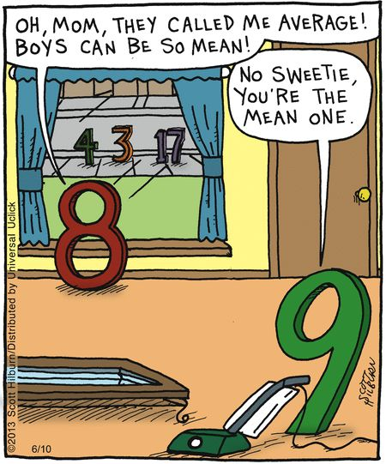

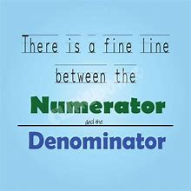
The Pun wall
Can you think of any?

Slide 3
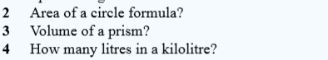
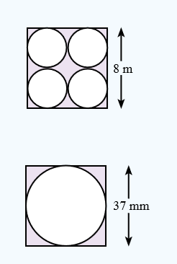
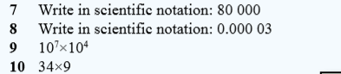
Always warm up so you don’t pull a brain cell.
Find the areas of the following composite shapes

Slide 4
Volume and Capacity EQ: What is the relationship between volume and capacity?
Volume - The volume of a three-dimensional figure is the amount of space within it.
Measured in Units Cubed (e.g. cm3)
Volume and capacity are related.
Capacity is the amount of material (usually liquid) that a container can hold.
Capacity is measured in millilitres, litres and kilolitres.

Slide 5
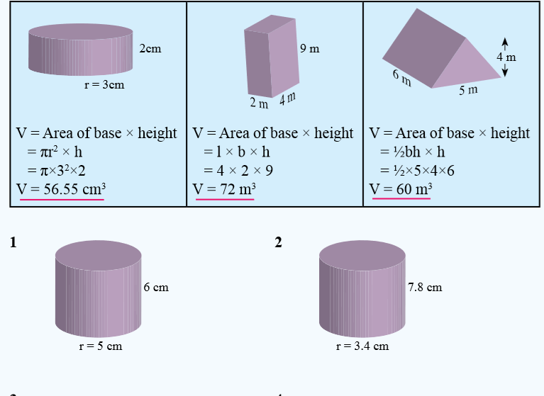
Review on Volume Prism Formulas

Slide 6
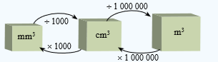
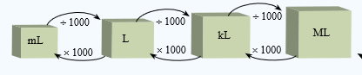
How does Volume relate to Capacity?
1000 mL = 1 L
1000 L = 1 kL
1 cm³ = 1 mL
1,000cm³ = 1000ml = 1L
1 m³ = 1000 L = 1 kL

Slide 7
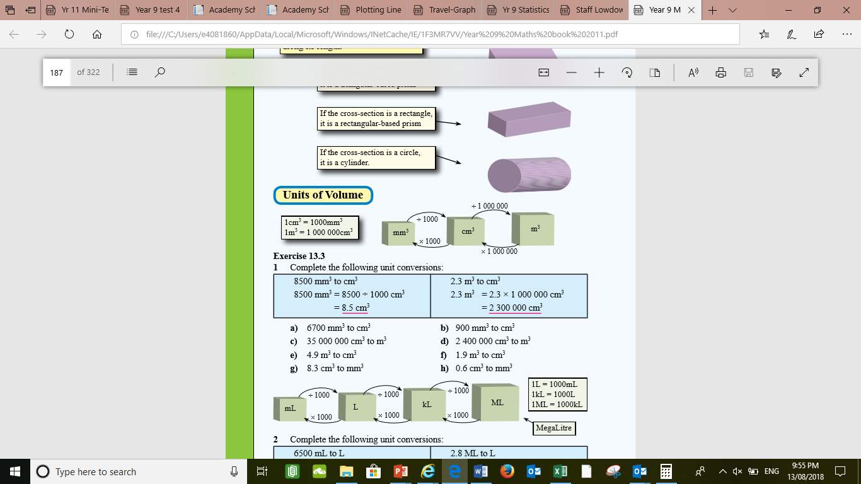
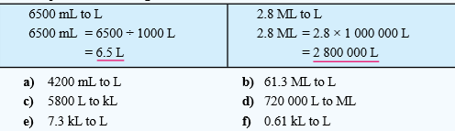
Practise converting units in volume and units in capacity.

Slide 8
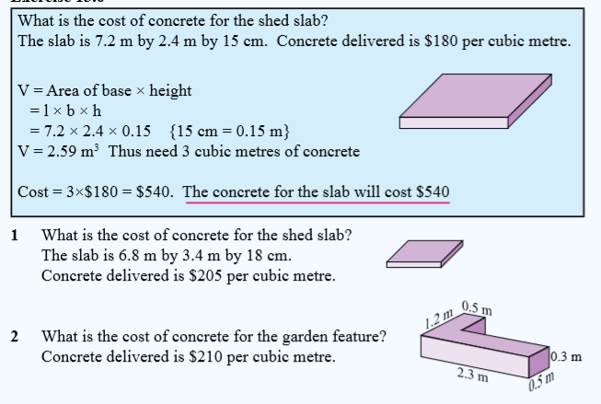
Volume and Capacity practise

Slide 9
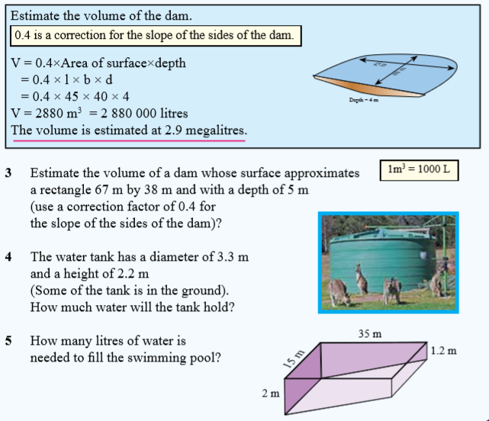

Slide 11
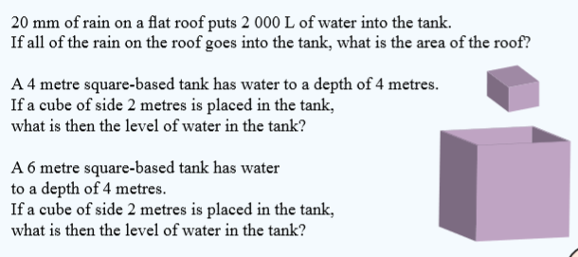
Competition Questions

Slide 12
Fermi Question
If I filled a Olympic Swimming pool with Fanta how many aluminium cans would it take to empty the pool?
You will have to make assumptions make sure you write them down and show your mathematical reasoning?

Slide 13

Thankyou and have a wonderful day
Recommendations to improve this lesson:

